Slide 1
BITS Pilani presentation
K. Venkata Ratnam
Mathematics

Slide 2
Course Number : SS ZC416
Course Title: MATHEMATICAL FOUNDATIONS
FOR DATA SCIENCE
Lecture No. :9

Slide 3
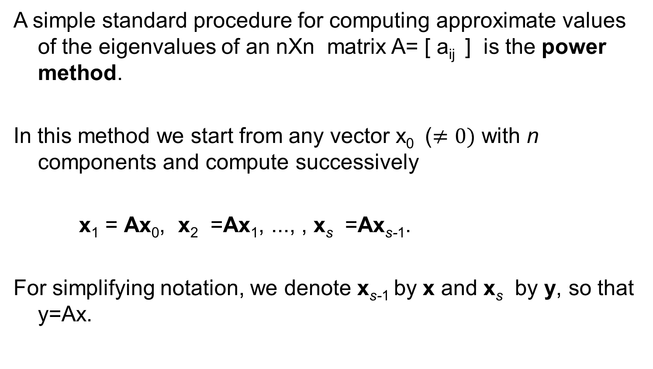
Power Method for Eigen values
A simple standard procedure for computing approximate values of the eigenvalues of an nXn matrix A= [ a_{ij} ] is the power method.
In this method we start from any vector x₀ ($≠0)$ with n components and compute successively
x₁ = Ax₀, x₂ =Ax₁, ..., , x_{s} =Ax_{s-1}.
For simplifying notation, we denote x_{s-1} by x and x_{s} by y, so that y=Ax.

Slide 4

Power method
The method applies to any nXn matrix A that has a dominant eigenvalue (a $λ$such that | $λ$| is greater than the absolute values of the other eigenvalues). If A is symmetric, it also gives the error bound (2), in addition to the approximation (1).

Slide 5
Theorem

Slide 8
Power method
The main advantage of the method is its simplicity. And it can handle sparse matrices too large to store as a full square array. Its disadvantage is its possibly slow convergence.
From the proof of Theorem 1 we see that the speed of convergence depends on the ratio of the dominant eigenvalue to the next in absolute value.
If we want a convergent sequence of eigenvectors, then at the beginning of each step we scale the vector, say, by dividing its components by an absolutely largest one.

Slide 9

Problem
Apply power method without scaling (3 steps ) using x₀ =[1 1 1]. Give Rayleigh quotients and error bounds for the matrix:
$$\left(\begin{matrix}4 & 2 & 3 \\ 2 & 7 & 6 \\ 3 & 6 & 4\end{matrix}\right)$$

Slide 10
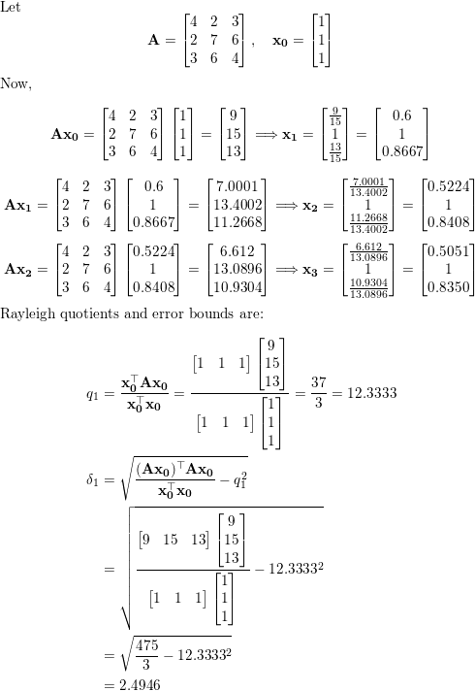
Sol

Slide 11
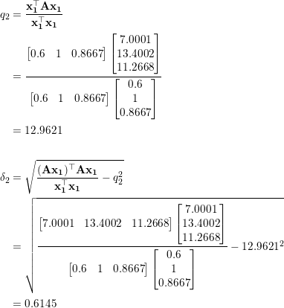
Sol

Slide 12
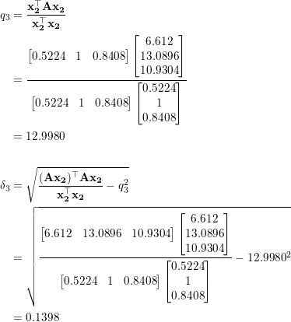
Sol

Slide 13
Set Theory

Slide 14
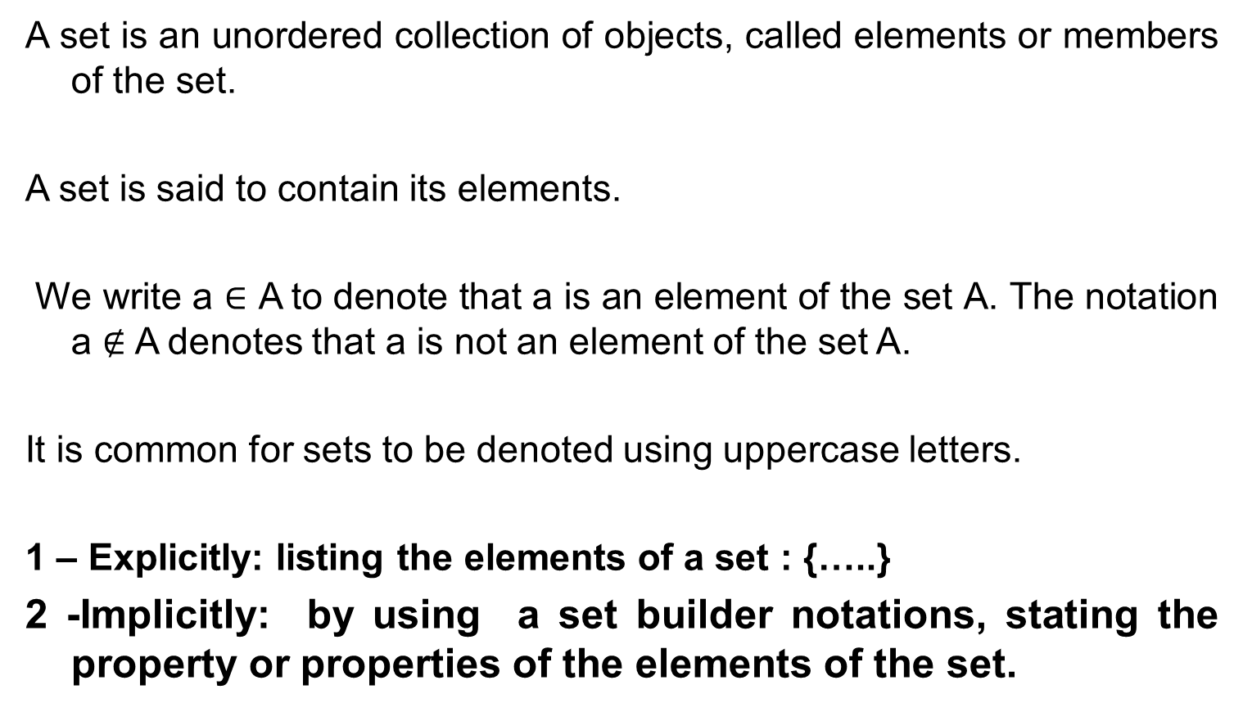
Definitions and notation
A set is an unordered collection of objects, called elements or members of the set.
A set is said to contain its elements.
We write a ∈ A to denote that a is an element of the set A. The notation a $∉$ A denotes that a is not an element of the set A.
It is common for sets to be denoted using uppercase letters.
1 – Explicitly: listing the elements of a set : {…..}
2 -Implicitly: by using a set builder notations, stating the property or properties of the elements of the set.

Slide 15
Important Sets:
N = {0,1,2,3,…}, the set of natural numbers, non negative integers, (occasionally IN).
Z = { …, -2, -1, 0, 1, 2,3, …), the set of integers.
Z⁺ = {1,2,3,…} set of positive integers.
Q = {p/q | p ∈ Z, q ∈Z, and q≠0}, set of rational numbers. : Set Builder form
R, the set of real numbers.
Note: Real number are the numbers that can be represented by an infinite decimal representation, such as 3.4871773339…. The real numbers include both rational, and irrational numbers such as π and the and can be represented as points along an infinitely long number line.
∅ = {} is the empty set, or the set containing no elements. ∅ ≠ {∅}

Slide 16
Definitions
Two sets are equal if and only if they have the same elements. Therefore, if A and B are sets, then A and B are equal if and only if ∀x(x ∈ A ↔ x ∈ B). We write A = B if A and B are equal sets.
Sets can be represented graphically using Venn diagrams.
In Venn diagrams the universal set U, which contains all the objects under consideration, is represented by a rectangle.
The set A is a subset of B if and only if every element of A is also an element of B. We use the notation A ⊆ B to indicate that A is a subset of the set B.

Slide 17
Definitions
For every set S, (i) ∅ ⊆ S and (ii) S ⊆ S.
A set A is a subset of a set B but that A ≠ B, we write A ⊂ B and say that A is a proper subset of B.
To show that two sets A and B are equal, show that A ⊆ B and B ⊆ A.
Let S be a set. If there are exactly n distinct elements in S where n is a nonnegative integer, we say that S is a finite set and that n is the cardinality of S. The cardinality of S is denoted by |S|.

Slide 18
Definitions
A set is said to be infinite if it is not finite :Ex: Set of positive integers.
Given a set S, the power set of S is the set of all subsets of the set S. The power set of S is denoted by P(S).
What is the power set of the empty set? What is the power set of the set {∅}?
Solution: The empty set has exactly one subset, namely, itself. Consequently, P(∅) = {∅}. The set {∅} has exactly two subsets, namely, ∅ and the set {∅} itself. Therefore, P({∅}) = {∅,{∅}}. ▲
If a set has n elements, then its power set has 2^{n} elements.

Slide 19
Definitions
The ordered n-tuple (a1, a2,...,an) is the ordered collection that has a1 as its first element, a2 as its second element,..., and an as its nth element.
Let A and B be sets. The Cartesian product of A and B, denoted by A × B, is the set of all ordered pairs (a, b), where a ∈ A and b ∈ B. Hence, A × B = {(a, b) | a ∈ A ∧ b ∈ B}.
The Cartesian product of the sets A1, A2,...,An, denoted by A1 × A2 ×···× An, is the set of ordered n-tuples (a1, a2,...,an), where a_{i} belongs to Ai for i = 1, 2,...,n. In other words, A1 × A2 ×···× An = {(a1, a2,...,an) | ai ∈ Ai for i = 1, 2,...,n}.

Slide 20
Definitions
Let A and B be sets. The union of the sets A and B, denoted by A ∪ B, is the set that contains those elements that are either in A or in B, or in both. : A ∪ B = {x | x ∈ A ∨ x ∈ B}.
Let A and B be sets. The intersection of the sets A and B, denoted by A ∩ B, is the set containing those elements in both A and B. A ∩ B = {x | x ∈ A ∧ x ∈ B}.
Two sets are called disjoint if their intersection is the empty set.
|A ∪ B|=|A|+|B|−|A ∩ B|:
The generalization of this result to unions of an arbitrary number of sets is called the principle of inclusion–exclusion. The principle of inclusion–exclusion is an important technique used in enumeration.

Slide 21
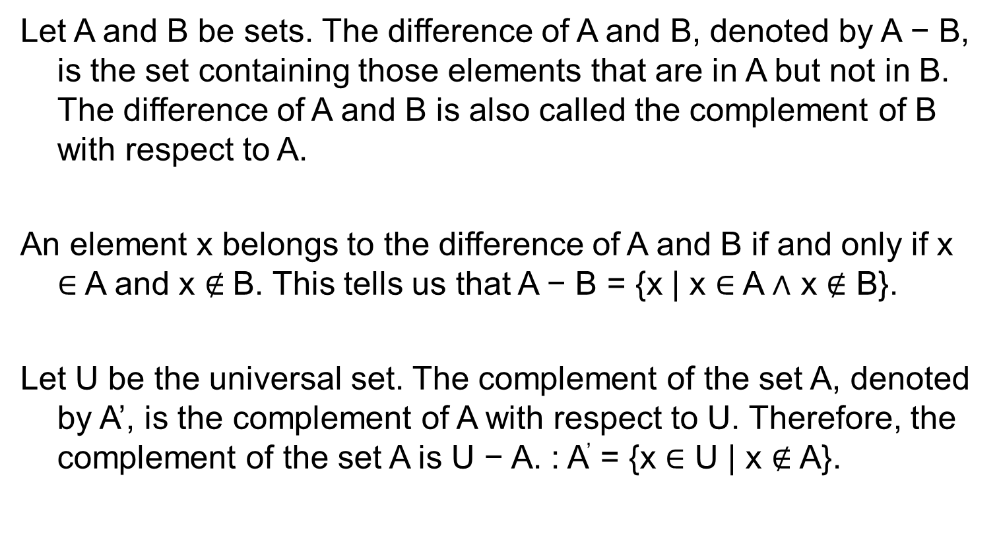
Definitions
Let A and B be sets. The difference of A and B, denoted by A − B, is the set containing those elements that are in A but not in B. The difference of A and B is also called the complement of B with respect to A.
An element x belongs to the difference of A and B if and only if x ∈ A and x $∉$B. This tells us that A − B = {x | x ∈ A ∧ x $∉$ B}.
Let U be the universal set. The complement of the set A, denoted by A’, is the complement of A with respect to U. Therefore, the complement of the set A is U − A. : A’ = {x ∈ U | x $∉$ A}.

Slide 22
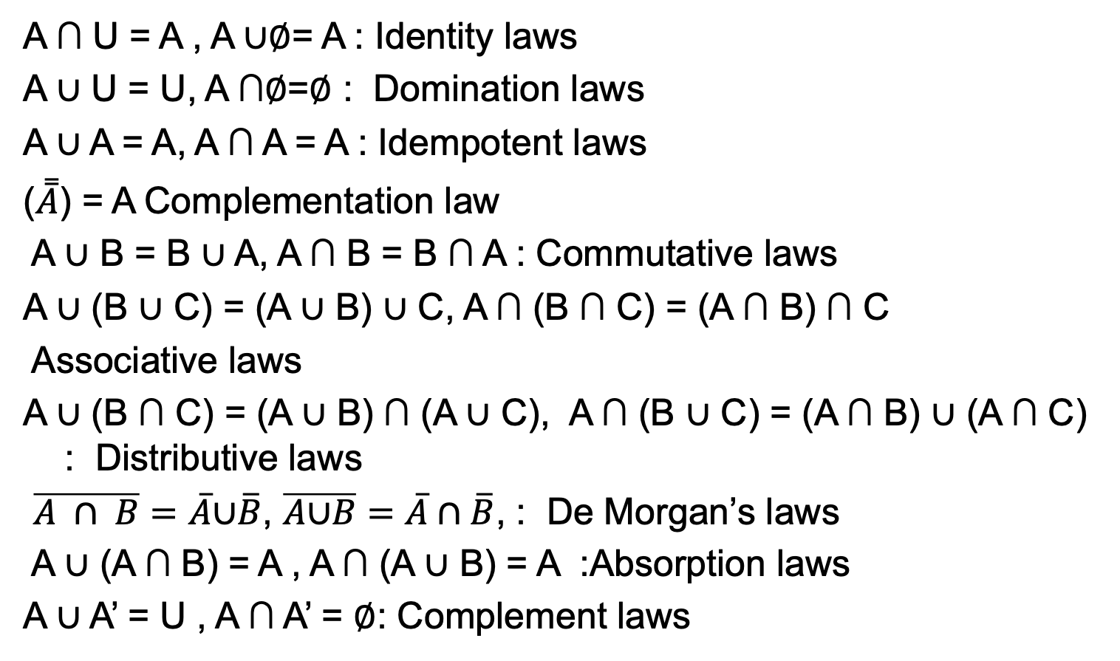
Set theory laws
A ∩ U = A , A ∪∅= A : Identity laws
A ∪ U = U, A ∩∅=∅ : Domination laws
A ∪ A = A, A ∩ A = A : Idempotent laws
($\overset{̿}{A}$) = A Complementation law
A ∪ B = B ∪ A, A ∩ B = B ∩ A : Commutative laws
A ∪ (B ∪ C) = (A ∪ B) ∪ C, A ∩ (B ∩ C) = (A ∩ B) ∩ C
Associative laws
A ∪ (B ∩ C) = (A ∪ B) ∩ (A ∪ C), A ∩ (B ∪ C) = (A ∩ B) ∪ (A ∩ C) : Distributive laws
$\overline{A ∩ B}=\overline{A}\text{∪}\overline{B}$, $\overline{A\text{∪}B}=\overline{A}∩\overline{B}$, : De Morgan’s laws
A ∪ (A ∩ B) = A , A ∩ (A ∪ B) = A :Absorption laws
A ∪ A’ = U , A ∩ A’ = ∅: Complement laws

Slide 23
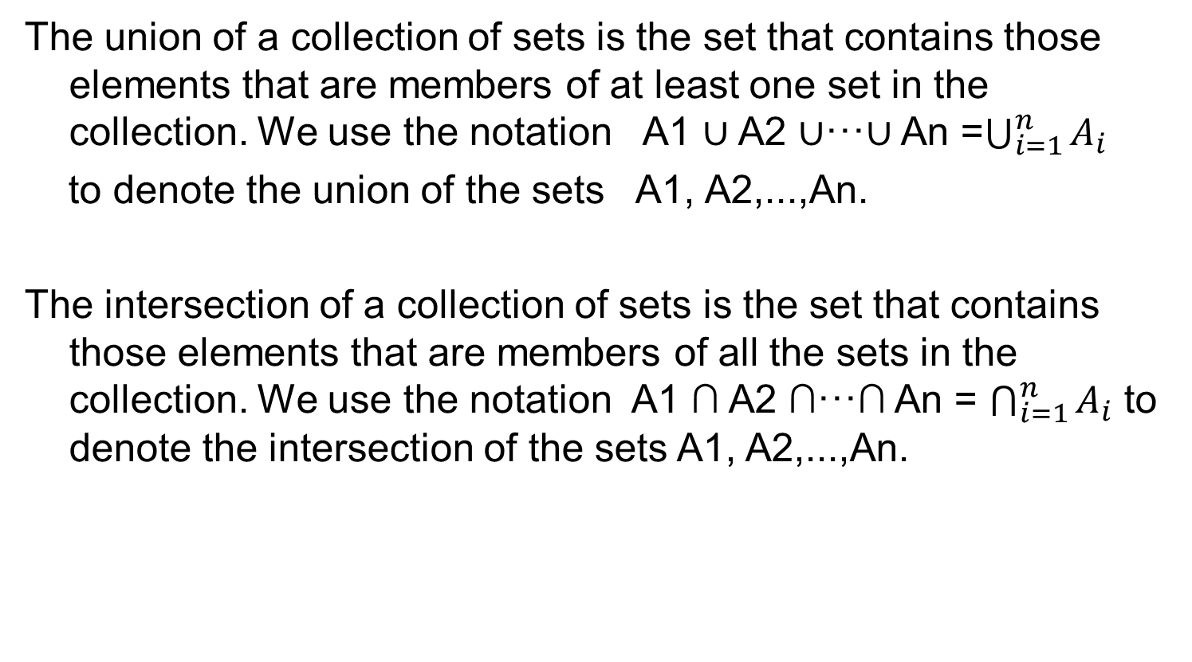
Definitions
The union of a collection of sets is the set that contains those elements that are members of at least one set in the collection. We use the notation A1 ∪ A2 ∪···∪ An =$\bigcup_{i=1}^{n}{A_{i}}$
to denote the union of the sets A1, A2,...,An.
The intersection of a collection of sets is the set that contains those elements that are members of all the sets in the collection. We use the notation A1 ∩ A2 ∩···∩ An = $\bigcap_{i=1}^{n}{A_{i}}$ to denote the intersection of the sets A1, A2,...,An.

Slide 24
Computer Representation of Sets:
Let U = {1, 2, 3, 4, 5, 6, 7, 8, 9, 10}, and the ordering of elements of U has the elements in increasing order; that is, ai = i. What bit strings represent the subset of all odd integers in U, the subset of all even integers in U, and the subset of integers not exceeding 5 in U?
Solution: The bit string that represents the set of odd integers in U, namely, {1, 3, 5, 7, 9}, has a one bit in the first, third, fifth, seventh, and ninth positions, and a zero elsewhere. It is 10 1010 1010. (We have split this bit string of length ten into blocks of length four for easy reading.)
Similarly, we represent the subset of all even integers in U, namely, {2, 4, 6, 8, 10}, by the string 01 0101 0101.
The set of all integers in U that do not exceed 5, namely, {1, 2, 3, 4, 5}, is represented by the string 11 1110 0000

Slide 25
Problems
1. Suppose that A={2, 4, 6}, B={2, 6}, C={4, 6}, and D={4, 6, 8}. Determine which of these sets are subsets of which other of these sets.?
Every set is a subset of itself.
B is a subset of A .
C is a subset of both A and D.

Slide 26
Problems
2. Determine whether each of these statements is true or false.
a) x ∈ {x} b) {x} ⊆ {x} c) {x} ∈ {x}
d) {x} ∈ {{x}} e) ∅ ⊆ {x} f ) ∅ ∈ {x}
T (in fact x is the only element)
T (every set is a subset of itself)
c) F (the only element of { x} is a letter, not a set)
d) T (in fact, { x} is the only element)
e) T (the empty set is a subset of every set)
f) F (the only element of { x} is a letter, not a set)

Slide 27
What is the cardinality of each of these sets?
a) ∅ 0
b) {∅} 1
c) {∅, {∅}} 2
d) {∅, {∅}, {∅, {∅}}} 3
What is the Cartesian product A cross B, where A is the set of courses offered by the mathematics department at a university and B is the set of mathematics professors at this university.
It is the set of all possible combinations of math courses and possible instructors

Slide 28
Problems
Can you conclude that A = B if A and B are two sets with the same power set?
Yes. By definition, P(A) is the set of all subsets that can be generated from A, if A and B generate the exact same collection of valid subsets, then it must be that A and B contain the same elements and are therefore equal.

Slide 29
Problems
Determine whether each of these sets is the power set of
a set, where a and b are distinct elements.
∅
{∅, {a}}
c) {∅, {a}, {∅, a}}
d) {∅, {a}, {b}, {a, b}}

Slide 30
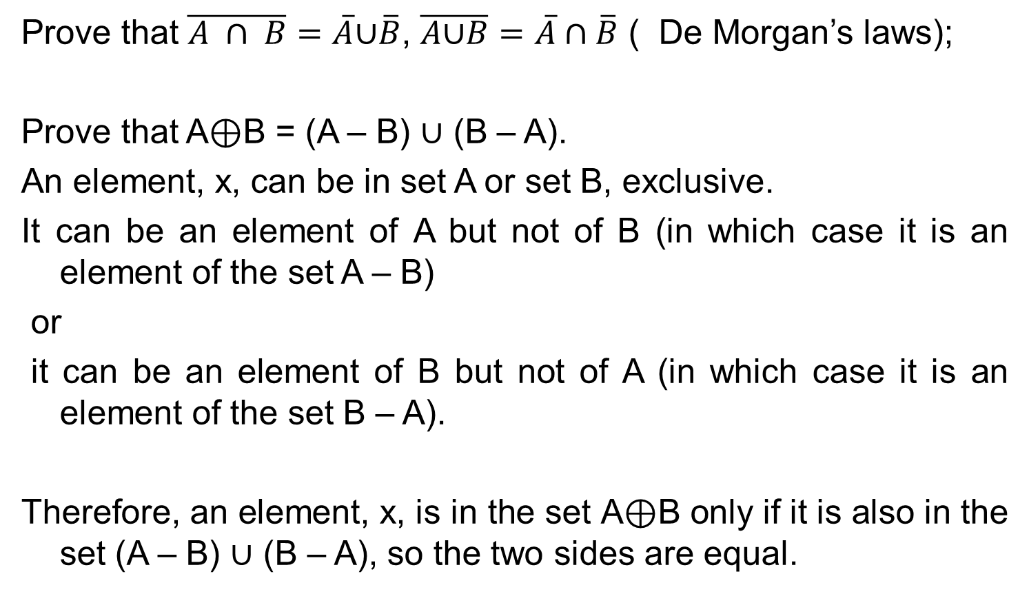
Problems
Prove that $\overline{A ∩ B}=\overline{A}\text{∪}\overline{B}$, $\overline{A\text{∪}B}=\overline{A}∩\overline{B}$ ( De Morgan’s laws);
Prove that A⊕B = (A – B) ∪ (B – A).
An element, x, can be in set A or set B, exclusive.
It can be an element of A but not of B (in which case it is an element of the set A – B)
or
it can be an element of B but not of A (in which case it is an element of the set B – A).
Therefore, an element, x, is in the set A⊕B only if it is also in the set (A – B) ∪ (B – A), so the two sides are equal.

Slide 31
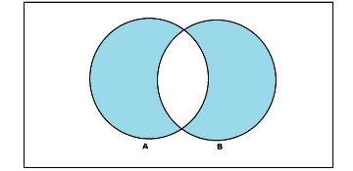
Problems
Draw venn diagram of the symmetric difference of the sets.
Draw venn diagram of (A-B)U(A-C)U (B-C).
Prove the distributive law.

Slide 32
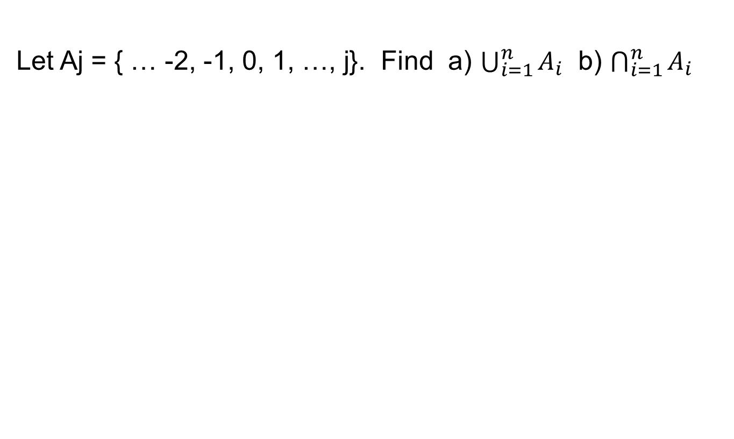
Problems
Let Aj = { … -2, -1, 0, 1, …, j}. Find a) $\bigcup_{i=1}^{n}{A_{i}}$ b) $\bigcap_{i=1}^{n}{A_{i}}$

